Slide 1
Technological Business Hackathon 2.0 (Round 2 prototype)
TEAM 23
ARNOV PAUL

Slide 2
Introduction
Hello everyone, I’m Arnov from SRM University AP where I’m a first year ECE student and this is my submission for the Round 2 of Technological Business Hackathon 2.0.
The SDG that I have chosen is SDG 3. Good Health And Well Being. We live in a country where the absence of technological advancements in the field of health and healthcare facilities is a huge problem. So I chose to give my contribution towards this. I hope that, by the end of this project I am able to contribute something meaningful.

Slide 3

Core Idea : VIRTUAL DOCTOR.

Slide 4
Objective
During my initial phase of SDG selection I came across a problem. The problem was that people these days are constantly suffering from minor ailments. But the shocking part is that many die because of constantly ignoring these minor ailments which turn out to be the symptoms of a life-threatening disease.
People worldwide are living longer. Today, for the first time in history, most people can expect to live into their sixties and beyond. A longer life brings with it opportunities, not only for older people and their families, but also for societies as a whole. The extent of these opportunities and contributions depends heavily on one factor: HEALTH.
In my project I am trying to make an user friendly website interface which can be used by the elderly and they can check if they are suffering from any major disease. It will be created with aged people in mind who are not used to smartphones or laptops. And above all it will all be totally free of cost.

Slide 5
Methodology
Step 1
Step 3
Program was created to extract neccessary data i.e,the symptom set etc.
Step 4
Step 2
Step 5
All the records of diseases and symptoms stored in a suitable format in a database.
A user friendly interface was made to simplify the user experience.
Program was created futhur and developed to show the symptom analysis in a suitable format.
Focus point for the project was selected and its requirements were analysed.

Slide 6
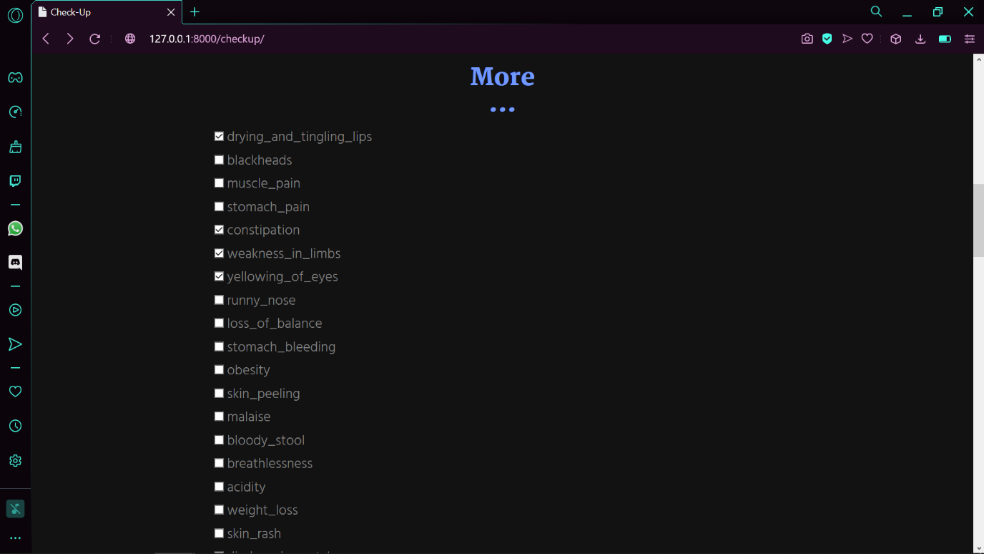
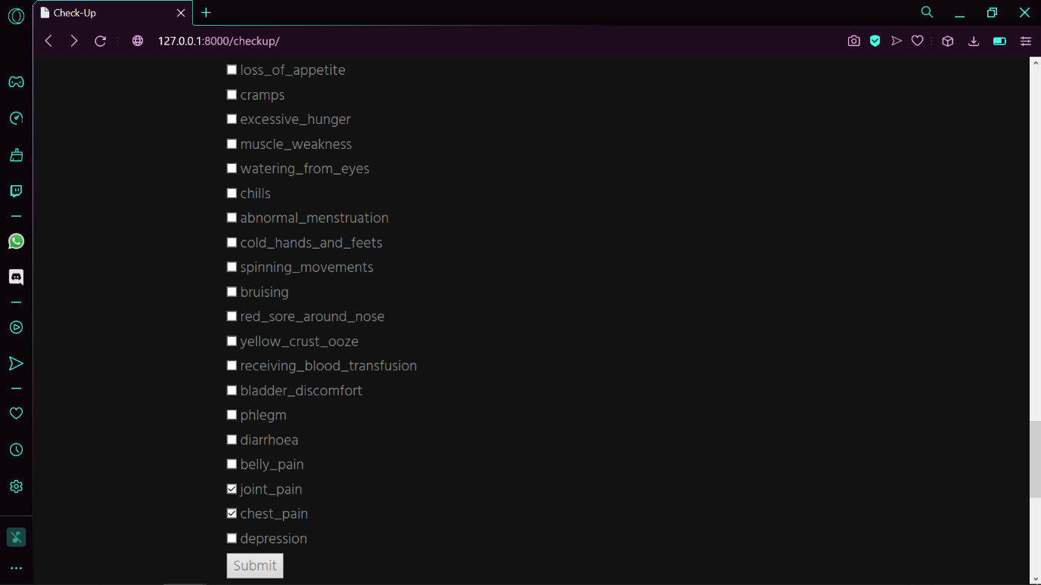
Result
Selecting The Symptoms- The user selects all the symptoms he/she thinks they have in this page.

Slide 7
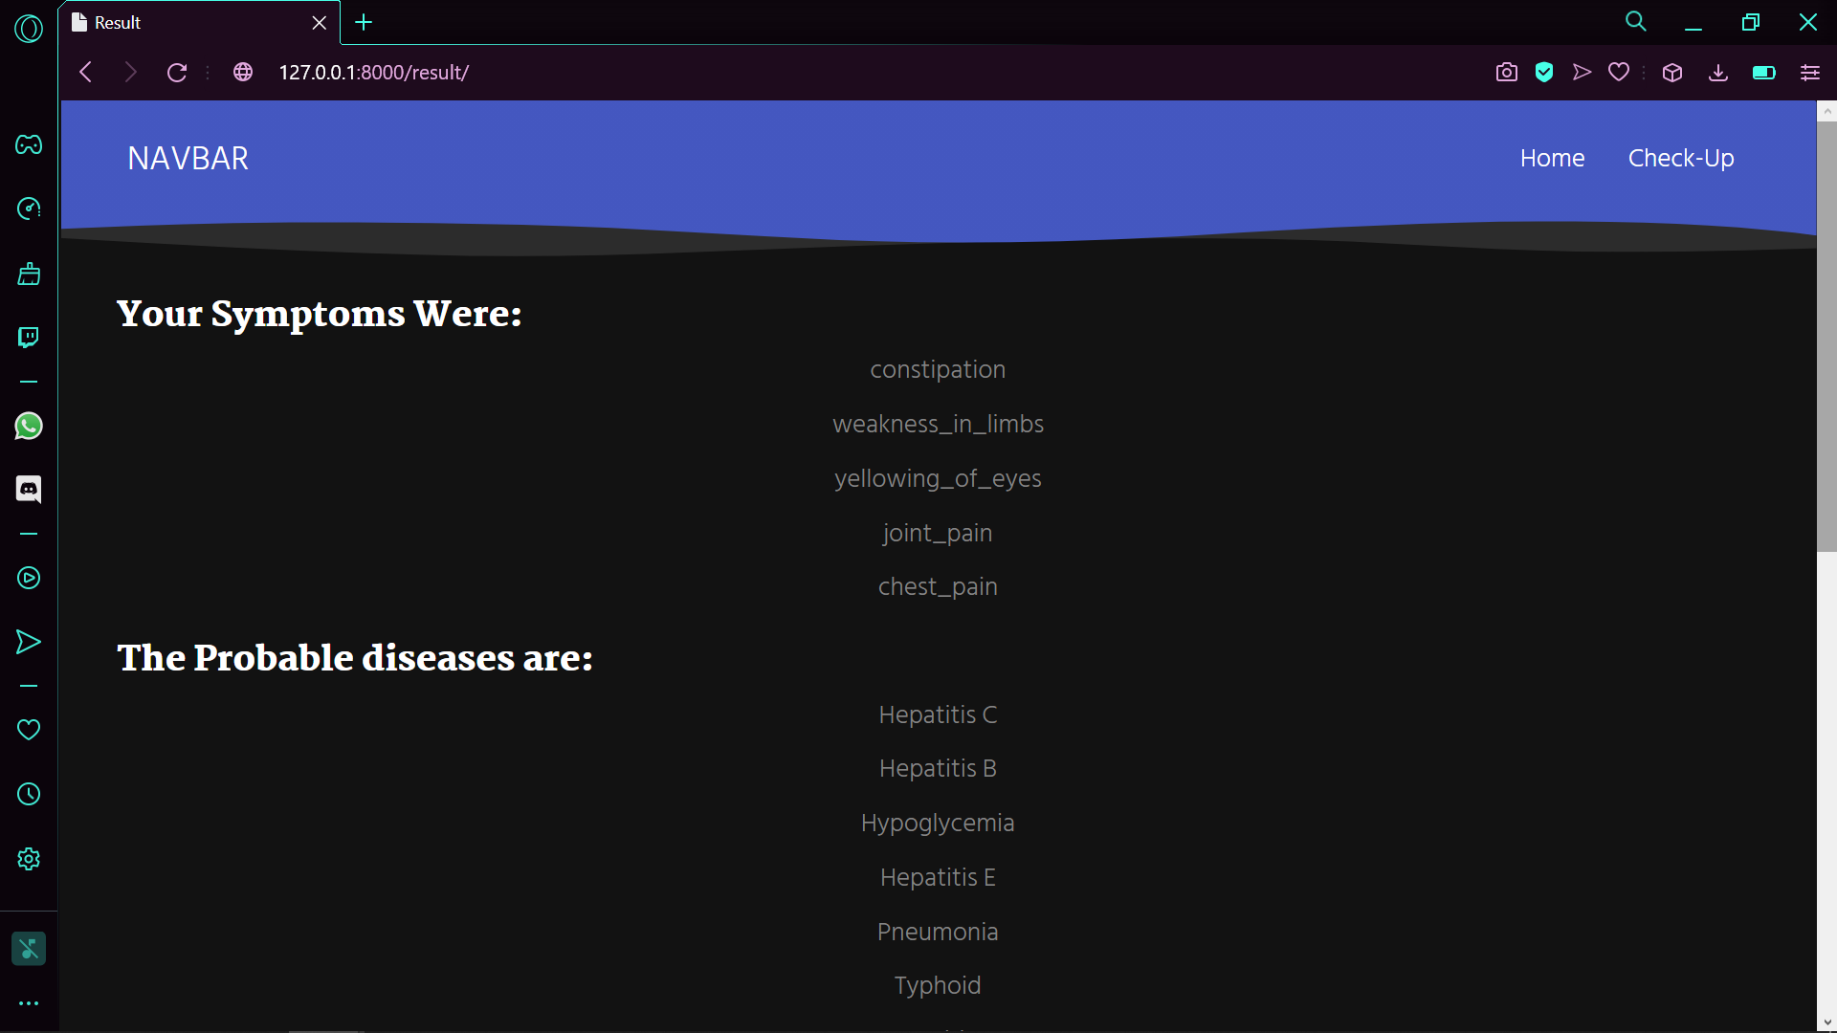
Result
Displaying the Suspected Diseases: Here the code displays the suspected disease(s) the user might be suffering from with respect to the symptoms it got in the form of input.

Slide 8




CODE
Tools Used-

Slide 9
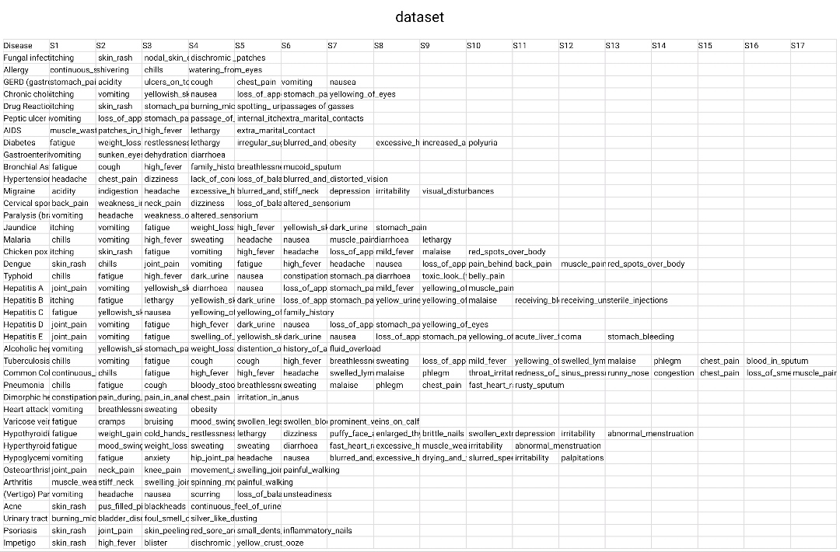
CODE
Dataset Used-

Slide 10
CODE
def dis(sym):
d={}
for i in sym:
csv_path = os.path.join(os.path.dirname(__file__), 'dataset.csv')
v=open(csv_path,"r")
df=csv.reader(v,delimiter=",")
dt=[]
for j in df:
for k in j[1:]:
if i in k:
dt.append(j[0])
break
d[i]=dt
ls=[]
f=common_member(d)
return f
def starter(alist):
lit=dis(alist)
return lit
if __name__ == '__main__':
starter()
Main Program-
import csv
import pandas as pd
import os
def common_member(a):
l=[]
res=[key for key in a.keys()]
for i in res:
l=l+a[i]
b=list(set(l))
return b

Slide 11
CODE
Program To Display it on HTML-
from django.shortcuts import render
from . import Virtual_Doctor_Copy1 as vd
# Create your views here.
def first(request):
return render (request,'index.html')
def checkup(request):
return render (request,'project.html')
def virtualdoc(request):
dict2={}
res=request.GET.getlist('checks[]')
a=vd.starter(res)
dict2={'data':a,'symptom':res}
return render(request,'components.html',dict2)

Slide 12
Conclusion
Health is something that is a concern to almost all of us, leading an ideal healthy life is everyone’s dream. The best outcome of my project would be when this won’t be required at all, when people start living a disciplined life by following proper diet and doing regular exercise. Because as we all know, HEALTH IS WEALTH.
I would like to conclude by saying that, by no means is this a great project but what I feel is that, this project gives me hope. Hope of it getting modified to greater heights, with more added features. By the use of AI we can take the feedback from patients of the disease which the were actually suffering from and improve our output. We can even add details of the disease that the user might be suffering from.
It’s just the beginning of many more great discoveries that we are yet to see, we are just at the tip of the iceberg.

Slide 13
Reference
https://www.kaggle.com/itachi9604/disease-symptom-description-dataset?select=dataset.csv
https://www.kaggle.com/itachi9604/disease-symptom-description-dataset?select=symptom_precaution.csv
https://www.kaggle.com/itachi9604/disease-symptom-description-dataset?select=symptom_Description.csv
https://en.unesco.org/sustainabledevelopmentgoals
https://github.com/mishal23
https://www.gigadocs.com/blog/should-we-ignore-minor-health-issues/

Slide 14
Acknowledgement
Lastly, I would like to thank all the members of AIESEC for guiding us throughout the THB 2.0 and I’d like to give a special shoutout to my mentor, Chandhu, because even after I gave up on the competition, she motivated me to at least compete in Round 2.

Slide 15
THANK YOU !!!

